Slide 1
In what ways does your media product use, develop or challenge forms and conventions of real media products?

Slide 2
Music video

Slide 3
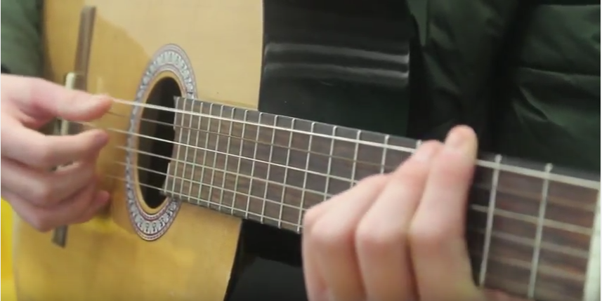
Performance
In my research into indie folk music videos, I noticed that in the majority of indie folk music videos have a form of performance within them. Therefore, we conformed with this convention and in our music video included levels of performance. We also conformed to other conventions of including narrative in our music video. For example, The Lumineers often have a mixture of narrative and performance in their videos.

Slide 4
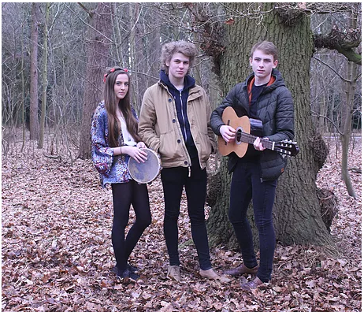
Costume
In my research, I noticed that indie folk bands and artists, such as Ben Howard, Mumford & Sons and The Lumineers wear a lot of denim along with neutral colours. Therefore, the two males wore neutral coloured shoes, denim and a neutral coloured jacket. Whilst the female wore denim shorts along with black tights because this is another piece of clothing I identified the females wearing in indie folk videos.

Slide 5
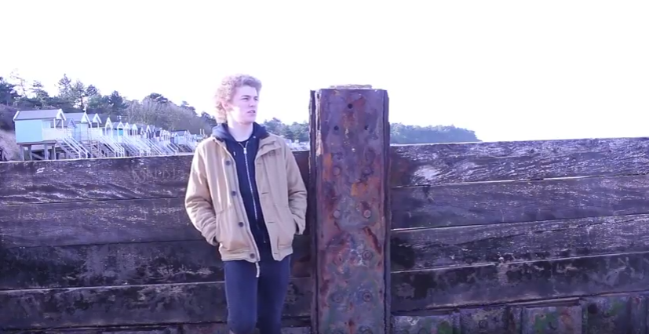
Lip syncing
This is something I noticed in all music videos, not just indie folk ones. Therefore, in our music video we contained large amounts of lip syncing. This is because it makes the song more personal to the artist as it looks like it is coming from them.

Slide 6
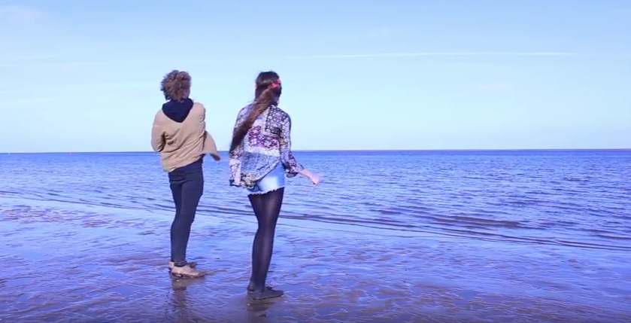
Location
In indie folk music videos I noticed that there are set the majority of the time in either fields or forests. I believe this is down to the fact they want to show off the countryside, the place where the genre was founded. Therefore, we conformed to this convention. However, we also used the beach as a location, which is somewhere I have yet to see feature in an indie folk video. Therefore, it could be seen to be challenging conventions.

Slide 7
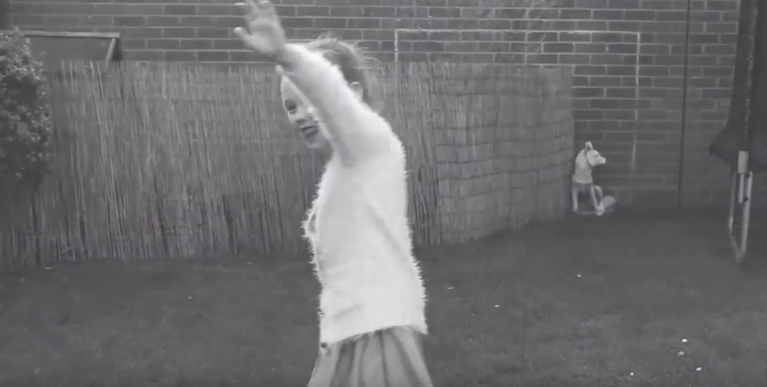
Brightness and contrasts
When I have analysed indie folk music videos, such as ‘Stubborn Love’ I noticed they changed the colouring of the scene to either encode a message or for effect, such as the past. Therefore, when editing I reduced the brightness on one scene for effect, whilst increasing the brightness on another scene to show their happiness. I also created an effect with the brightness and contrast to show the past.

Slide 8
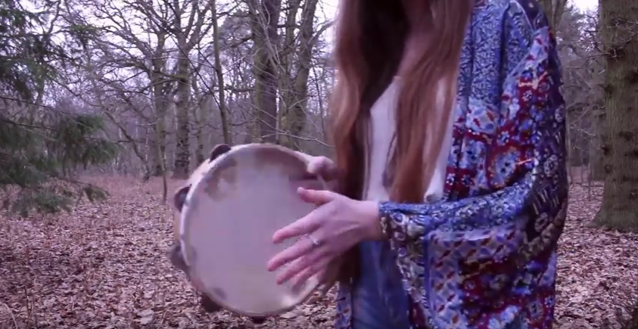
Timing
In all music videos, to gather rhythm within the video, the shot change usually corresponds with the beat of the song. This is to create rhythm in the video that works with the song to create a smooth transition. In the chorus of the song, we tried to correspond the beating of the tambourine with the beating in the song. Therefore, we conformed to this convention.

Slide 9
Digipak

Slide 10
Images
In my research, I noticed that an image of the band or artist is used on the front cover. I have conformed to this convention as well as having the image at eye line level, so that it makes it more personal for the audience as it feels as though the band is looking at them. However, I have challenged the convention of having a close-up of the artist on the front cover. Instead I have opted to use a long shot.

Slide 11
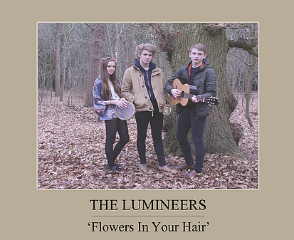
Titles
All most every digipak has the band or artist name on the front in the centre. This is something that I have conformed to because on my digipak in the centre of the page along with the image is the band name and song title. This is so that it is in the eye line of the audience, so that it is one of the first things they see.

Slide 12
Font
The font used on indie folk digipaks is usually in a old fashioned style. This is because it then gives the impression that it is indie folk as the genre was discovered years ago. Therefore, I have conformed to this and used an old fashioned style of text with the use of Sans and serifs.

Slide 13
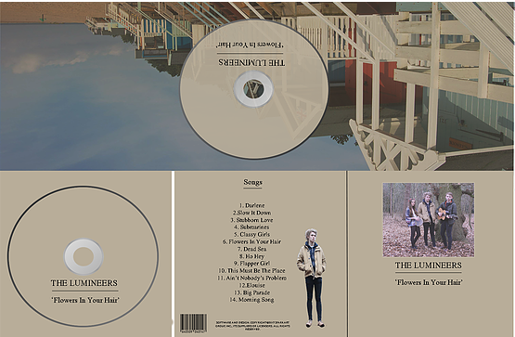
Layout
All digipaks, are produced in a book-style way. This means that the front cover opens to show the extra panel with the inside sections behind that. This is something I have conformed to. On the back cover is also the song list. This can be seen on all digipaks not just indie folk ones. Therefore, I have conformed to this convention as well and placed the song list on the back cover.

Slide 14
Magazine advert

Slide 15
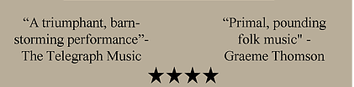
Reviews
I noticed that most magazine adverts have reviews on them to try and increase sales. This is because if the audience see that the album has good reviews they are more likely to purchase it. Therefore, I added two reviews to my magazine advert, which means that I conformed to this convention.

Slide 16
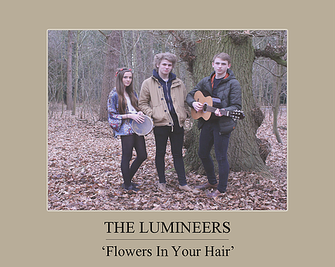
Name and image of the artist or band
Just like on digipaks, one main convention of a magazine advert is to have the band or artists name on the front. This is something I saw and thought about when constructing my magazine advert. I ended up placing the name underneath the image, which means that I conformed to the convention.

Slide 17

Release dates
Another convention I noticed was the use of digipak release dates. These are placed on the magazine advert to cause hype around the product, which will increase sales. This is something I therefore thought about when designing my advert. As I included release dates on my magazine advert, I have conformed to this convention.

Slide 18
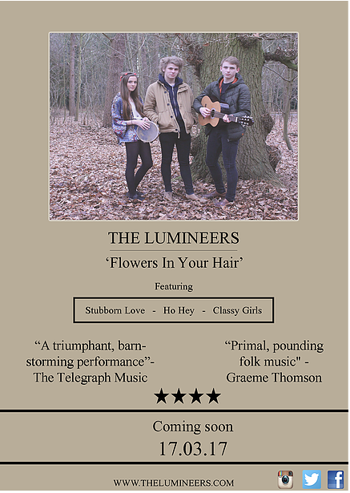
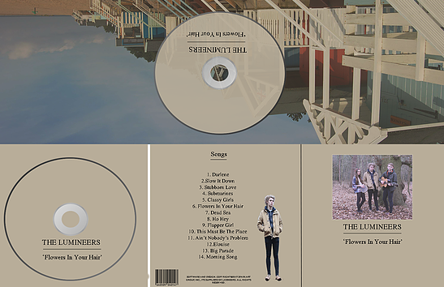
Consistency
On every magazine advert, there is a level of consistency between the advert and the digipak. This is so that there is an identity formed within the product. This is something I saw on most digipaks and magazine adverts, so I included it in my own. This means that I have conformed to another convention.

